Slide 1
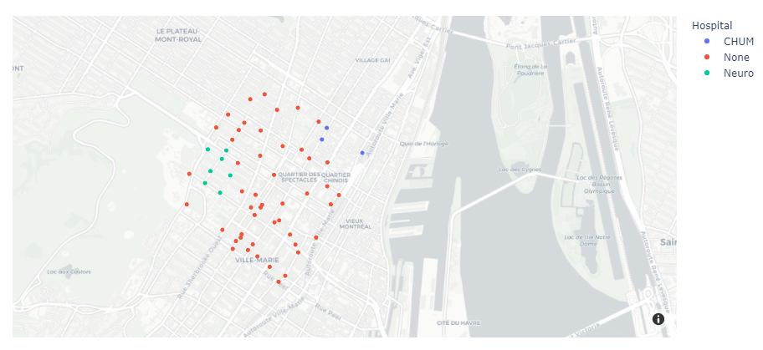

Slide 2
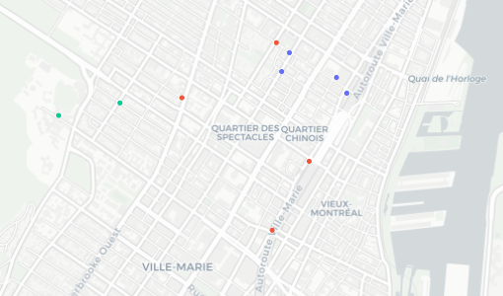
Before
7
8
5
6
4
1
2
3

Slide 3
After
6
2
5
3
4
1
8
7

